Slide 1
Angular Sharing
11-10-2021

Slide 2
Agenda
Prerequisites
What/Why is Angular?
Basic concepts
How an Angular App gets Loaded and Started
Introduction to NgModules
Introduction to Components
Introduction to Template
View Encapsulation
Shadow DOM
Data Binding
What is Directives, Pipes?
Local References in Templates and ViewChild in Components
Content projection
Component Lifecycle
Change Detection
Demonstration: coding example

Slide 3
Agenda
Service & Dependency Injection
Routing
RxJS
Making http requests
Template Driven form and Reactive form
Others
Angular Internationalization
Angular Universal
State Management: NgRx,...
Dynamic Components
Angular Element
Angular Animation
Testing

Slide 4
Prerequisites
HTML
JavaScript
TypeScript
Node.js and npm (node package manager) https://nodejs.org/en/
Webpack https://webpack.js.org/
Angular CLI https://www.npmjs.com/package/@angular/cli

Slide 5
What/Why is Angular
Open-source front-end framework developed by Google
Built on TypeScript
Creating dynamic, modern web apps
Component-based
Well-integrated libraries
Support Testing
Single Page Application E.g: https://angular.io/

Slide 6
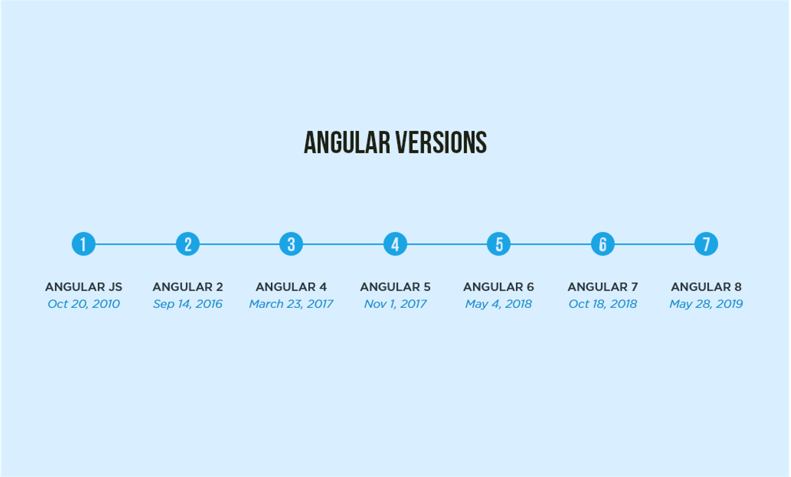
Angular Journey
A major release every 6 months
1-3 minor releases for each major release
A patch release and pre-release (next or rc) build almost every week
Current stable release: 12.1.4 / 28 July 2021

Slide 7
Basic Concepts
Modules (NgModules)
Components
Templates, directives, and data binding
Services and dependency injection

Slide 8
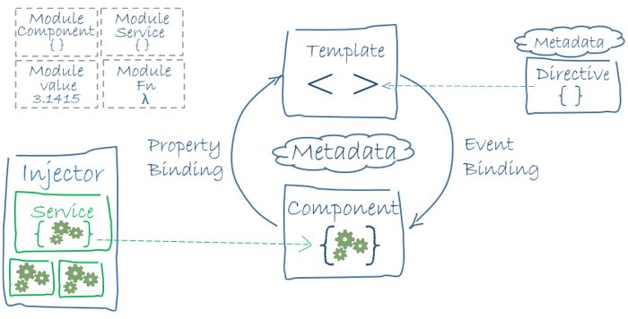
Basic Concepts
Component
{
...
}

Slide 9
How an Angular App gets Loaded and Started
Create a new project:
ng new {project_name}
Build the project:
ng build --configuration {environment}
Start and watch the project locally:
ng serve --port {port_number}
Angular cli (ng serve / ng build) rebuild the project, it will create javascript bundles, and automatically add the right imports in the index.html file
angular.json:
main: main.ts -> root Module -> other Modules and Components
outputPath: index.html, main.js, polyfills.js, runtime.js, vendor.js, ...

Slide 10
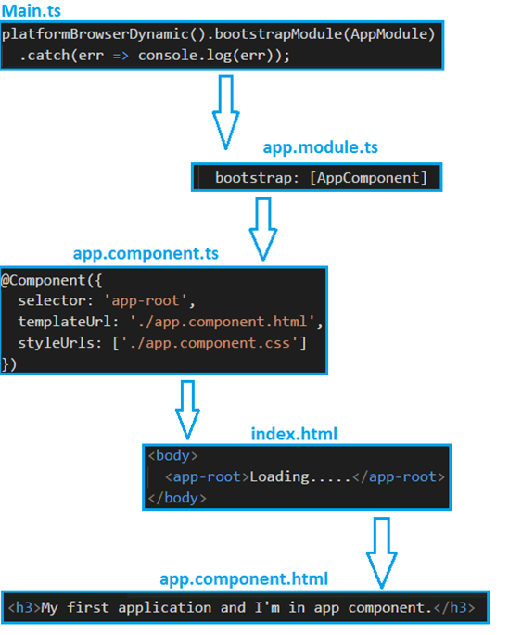
How an Angular App gets Loaded and Started

Slide 11
Introduction to NgModules
Angular modularity system
Containers for a cohesive block of code
Can contain components, service providers, and other NgModules
Every Angular application has at least one NgModule class (root Module) to bootstrap root components

Slide 12
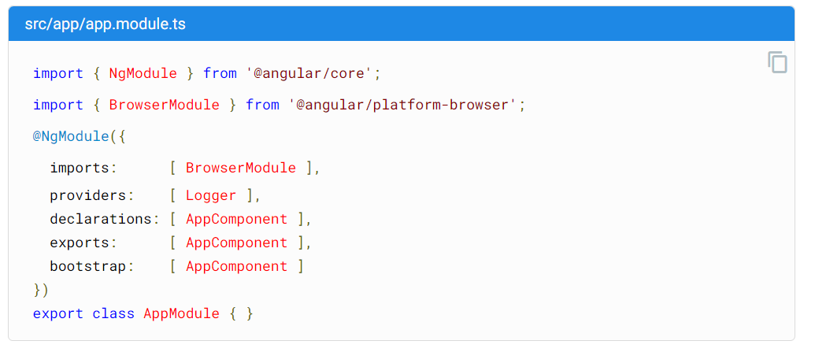
Introduction to NgModules
(Metadata)
Other Modules
Injectable Services (classes, interfaces)
Components, Directives, and Pipes
Components, Directives, and Pipes to share with other Modules
Root components to be declared in index.html file

Slide 13
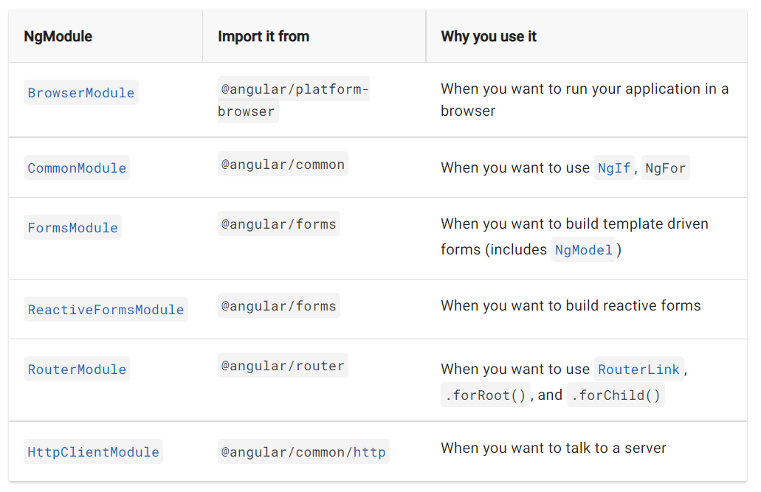
Introduction to NgModules
(Frequently-used Modules)

Slide 14
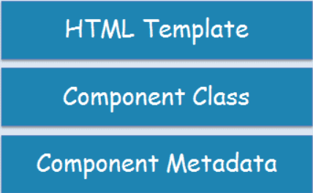
Introduction to Components
Building blocks that compose an application
TypeScript class with a @Component() decorator
HTML template, and styles
Angular Component

Slide 15
Introduction to Components
(Metadata)
The @Component() decorator specifies Metadata:
selector: A CSS selector that tells Angular to create and insert an instance of this component wherever it finds the corresponding tag in template HTML
templateUrl: The module-relative address of this component's HTML template
template: inline HTML template
providers: An array of providers for services that the component requires
styles: takes an array of strings that contain CSS code
styleUrls: Load styles from external CSS files

Slide 16
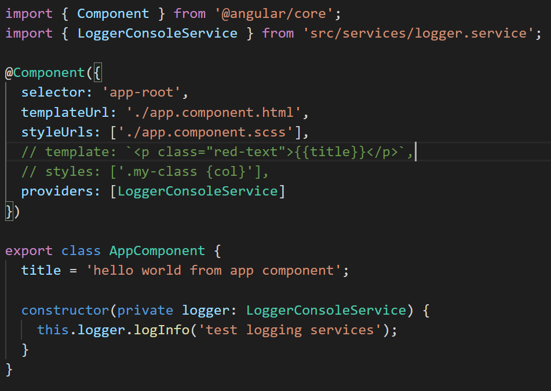
Introduction to Components

Slide 17
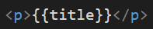
Introduction to Templates
Is a chunk of HTML that declares how that component renders
Defined by either inline or by file path
Extends HTML with additional syntax help inserting dynamic values from the component and dynamically render the html contents
Interpolation: {{}}
Template statements:
Data binding
Directive
Pipes
Template variables

Slide 18
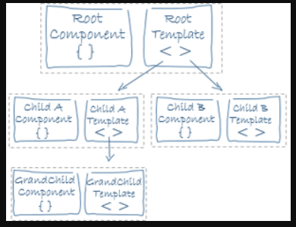
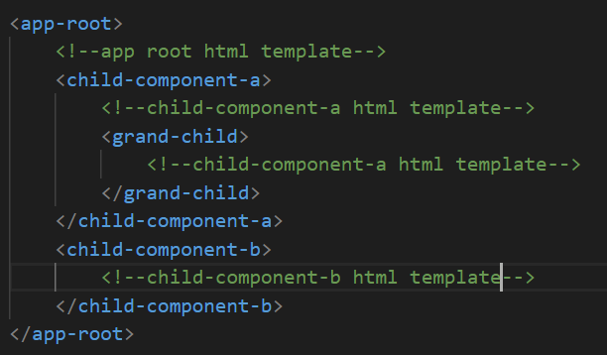
Introduction to Templates
Views are typically arranged hierarchically

Slide 19
View Encapsulation
Component CSS styles are encapsulated into the component's view and don't affect the rest of the application
ShadowDom view encapsulation uses the browser's built-in shadow DOM implementation
Emulated view encapsulation (the default) emulates the behavior of shadow DOM by preprocessing
None means that Angular does no view encapsulation. Angular adds the CSS to the global styles

Slide 20
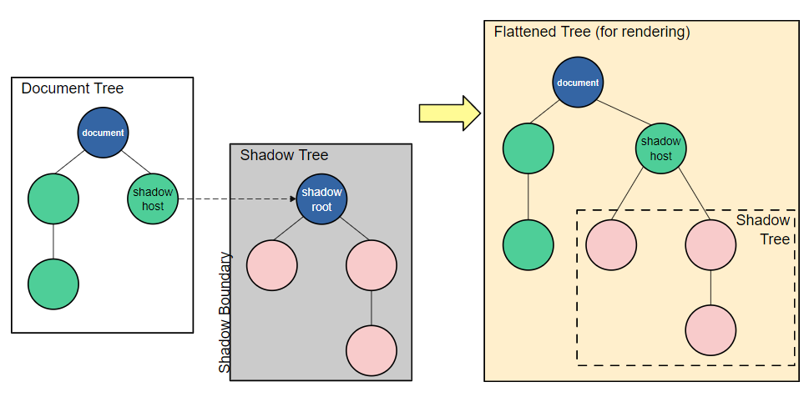
Shadow DOM (https://developer.mozilla.org/en-US/docs/Web/Web_Components/Using_shadow_DOM)

Slide 21
Data Binding
Without a framework, how to pushing data values into the HTML controls and turning user responses into actions and value updates:
Access DOM elements by ids, classes,...
Set/update data to DOM; get values, listen events from DOM by javascript
Writing such push and pull logic by hand is tedious, error-prone, and a nightmare to read

Slide 22
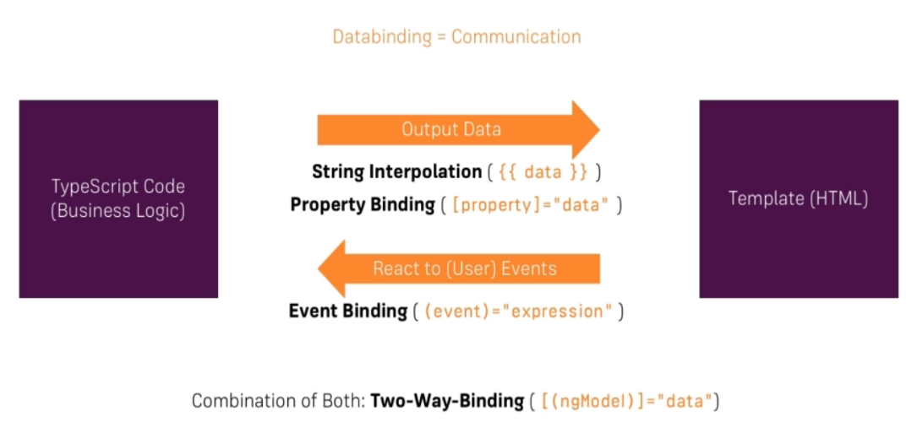
Data Binding

Slide 23
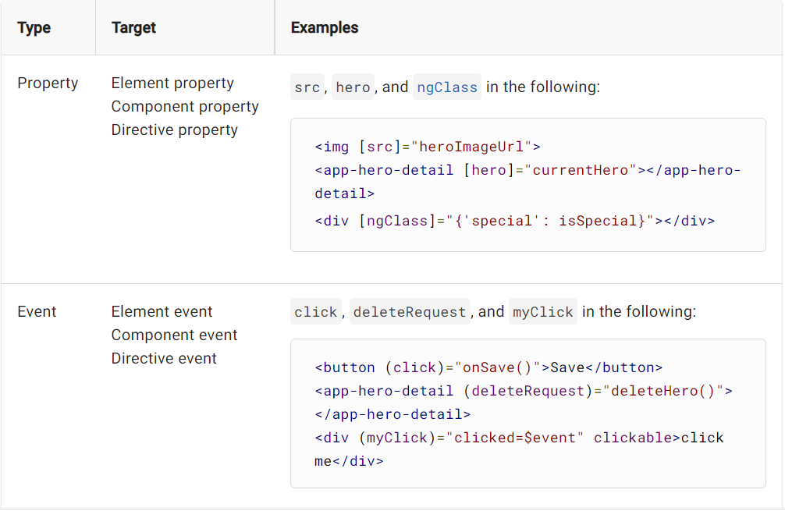
Data Binding
Binding types and targets

Slide 24
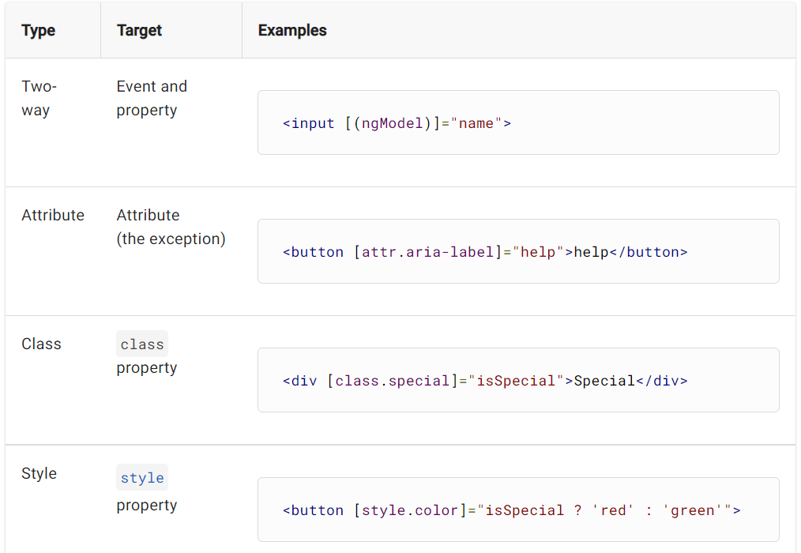
Data Binding
Binding types and targets

Slide 25
Data Binding
Parent ⇔ Child
@Input() and @Output() give a child component a way to communicate with its parent component
@Input() lets a parent component update data in the child component. Conversely
@Output() lets the child send data to a parent component

Slide 26
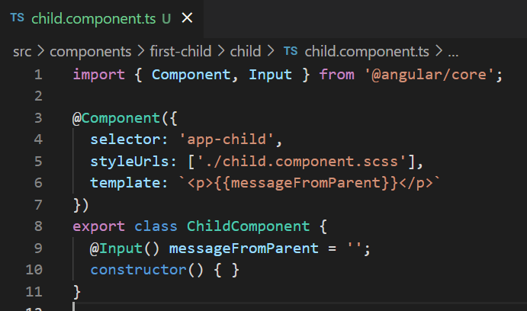
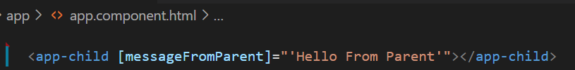
Data Binding
Parent => Child: @Input()

Slide 27
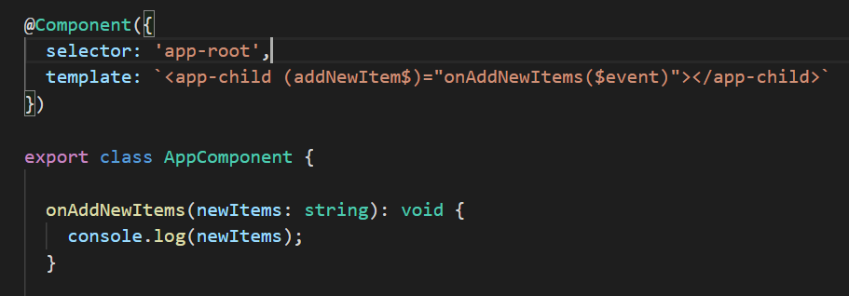
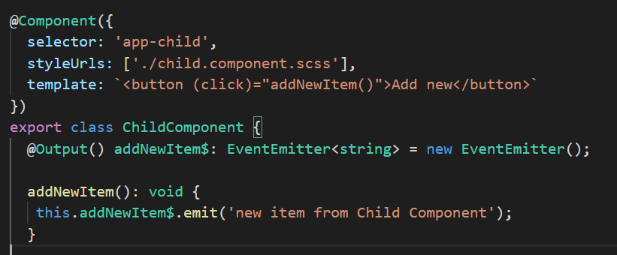
Data Binding
Parent <= Child: @Output()

Slide 28
Data Binding
Behind the scene
function addEventListener(eventName, callback) {
// call the real addEventListener
callRealAddEventListener(eventName, function() {
// first call the original callback
callback(...);
// and then run Angular-specific functionality
var changed = angular2.runChangeDetection();
if (changed) {
angular2.reRenderUIPart();
}
});
}
In short, the framework will trigger a change detection if one of the following events occurs:
any browser event (click, keyup, etc.)
setInterval() and setTimeout()
HTTP requests via XMLHttpRequest
Force manually using ChangeDetectorRef
Angular uses its zone called NgZone to wrap asynchronous browser APIs, and notify a consumer when an asynchronous task has started or ended

Slide 29
Directives
Directives are classes that add additional behavior to elements in your Angular applications
Components—directives with a template
Attribute directives—directives that change the appearance or behavior of an element, component, or another directive
Structural directives—directives that change the DOM layout by adding and removing DOM elements

Slide 30
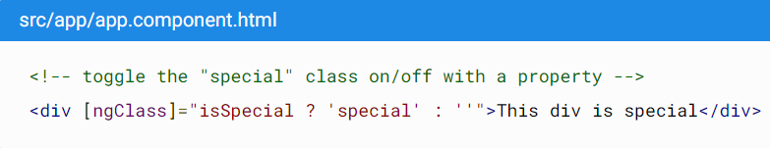
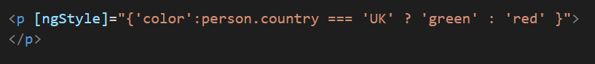
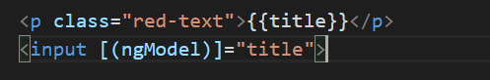
Built-in attribute Directives
NgClass—adds and removes a set of CSS classes.
NgStyle—adds and removes a set of HTML styles.
NgModel—adds two-way data binding to an HTML form element.

Slide 31
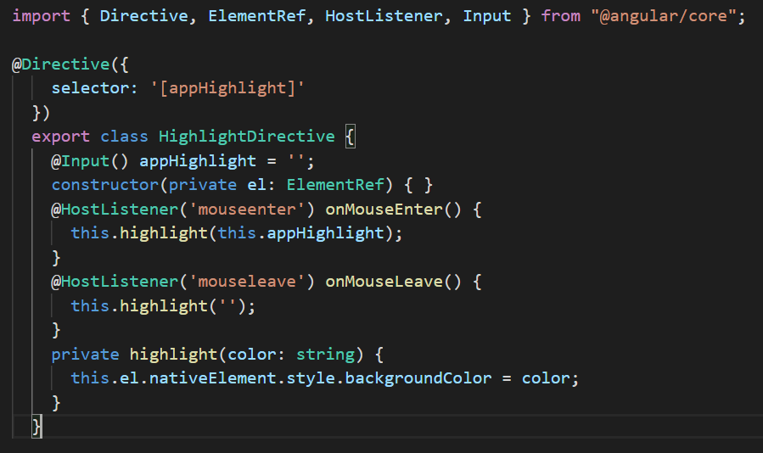
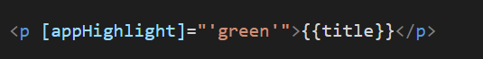
Building an attribute Directives

Slide 32
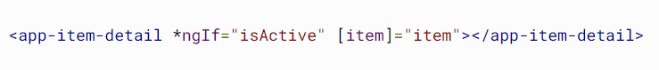
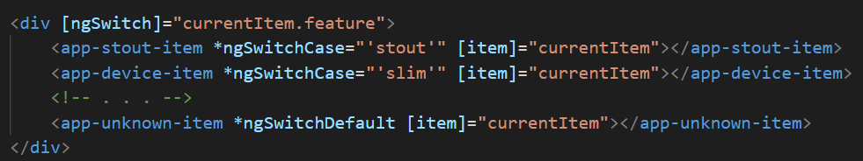
Built-in structural Directives
NgIf: conditionally creates or disposes of subviews from the template.
NgFor: repeat a node for each item in a list.
NgSwitch: a set of directives that switch among alternative views.

Slide 33
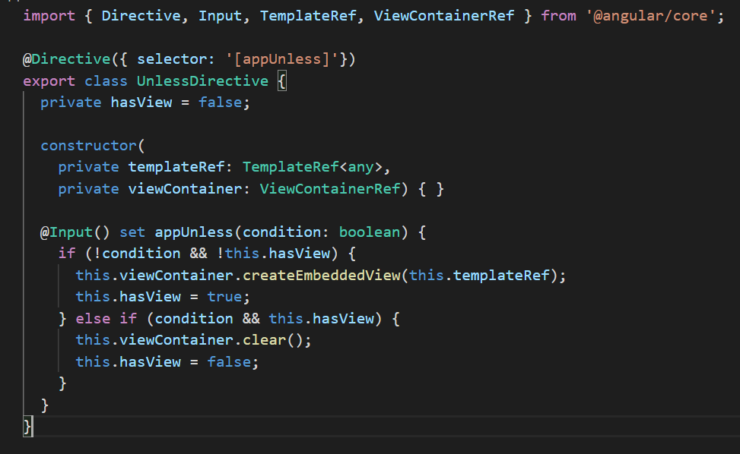
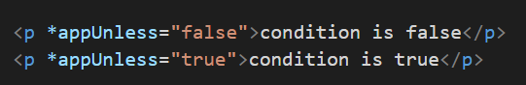
Building a structural Directives
Creating an UnlessDirective - oposite to ngIf

Slide 34
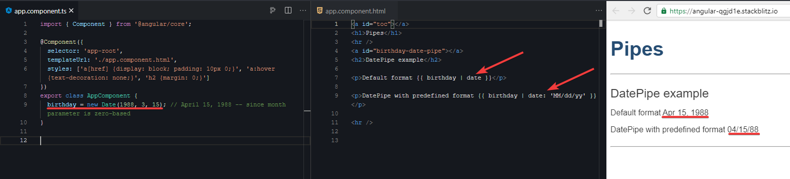
Pipe
Pipes are simple functions to use in template expressions to accept an input value and return a transformed value.
Pipes can be used throughout Angular application, while only declaring each pipe once
Example: using built-in pipe “DatePipe”. live demo

Slide 35
Built-in pipes provided by Angular
DatePipe: Formats a date value according to locale rules.
{{ value_expression | date [ : format [ : timezone [ : locale ] ] ] }}
UpperCasePipe: Transforms text to all upper case.
{{ value_expression | uppercase }}
LowerCasePipe: Transforms text to all lower case.
{{ value_expression | lowercase }}
CurrencyPipe: Transforms a number to a currency string, formatted according to locale rules.
{{ value_expression | currency [ : currencyCode [ : display [ : digitsInfo [ : locale ] ] ] ] }}
DecimalPipe: Transforms a number into a string with a decimal point, formatted according to locale rules.
{{ value_expression | number [ : digitsInfo [ : locale ] ] }}
PercentPipe: Transforms a number to a percentage string, formatted according to locale rules.
{{ value_expression | percent [ : digitsInfo [ : locale ] ] }}

Slide 36
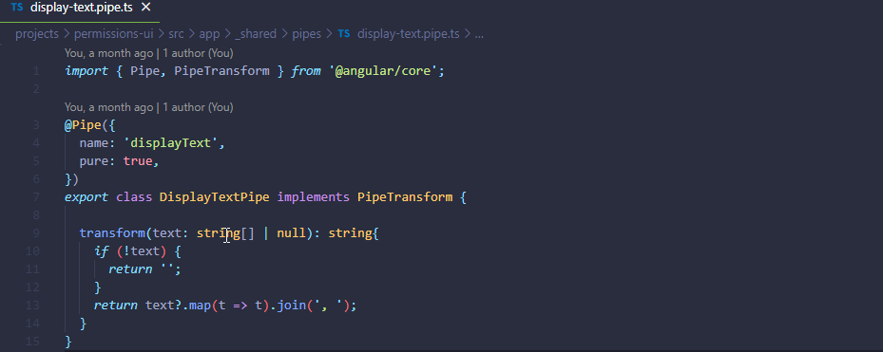
Create a custom pipe
Purpose:
Create custom pipes to encapsulate transformations that are not provided with the built-in pipes.
How to create:
To mark a class as a pipe and supply configuration metadata, apply the @Pipe decorator to the class
Use UpperCamelCase (the general convention for class names) for the pipe class name, and camelCase for the corresponding name string. Note: Do not use hyphens( - ) in the name
Implement the PipeTransform interface in your custom pipe class to perform the transformation
Example: this pipe below will concat an array string into one string, split by a comma( , ). Then display in UI
Live demo

Slide 37
Content projection
Content projection is a pattern in which you insert, or project, the content you want to use inside another component.
Using <ng-content> element where you want the projected content to appear in the template of the component
Common implementations of content projection in Angular:
Single-slot content projection. With this type of content projection, a component accepts content from a single source.
Multi-slot content projection. In this scenario, a component accepts content from multiple sources.
Conditional content projection. Components that use conditional content projection render content only when specific conditions are met.
Reference: https://angular.io/guide/content-projection

Slide 38
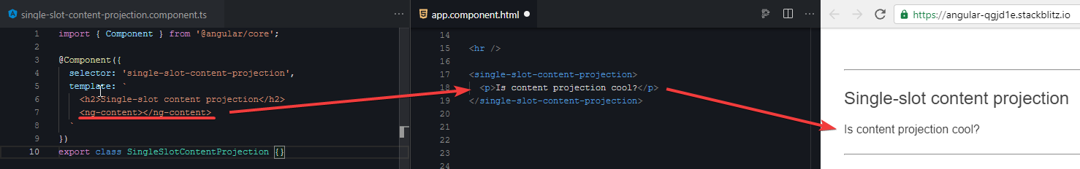
Single-slot content projection
Single-slot content projection refers to creating a component into which you can project one component.
To create a component that uses single-slot content projection:
Create a component.
In the template for your component, add an <ng-content> element where you want the projected content to appear.
Note: The <ng-content> element is a placeholder that does not create a real DOM element. Custom attributes applied to <ng-content> are ignored.
Live demo

Slide 39
Multi-slot content projection
A component can have multiple slots. Each slot can specify a CSS selector that determines which content goes into that slot.
You must specify where you want the projected content to appear by using the select attribute of <ng-content>.
To create a component that uses multi-slot content projection:
Create a component.
In the template for your component, add an <ng-content> element where you want the projected content to appear.
Add a select attribute to the <ng-content> elements. Angular supports selectors for any combination of tag name, attribute, CSS class, and the :not pseudo-class.
For example, the following component uses two <ng-content> elements.

Slide 40
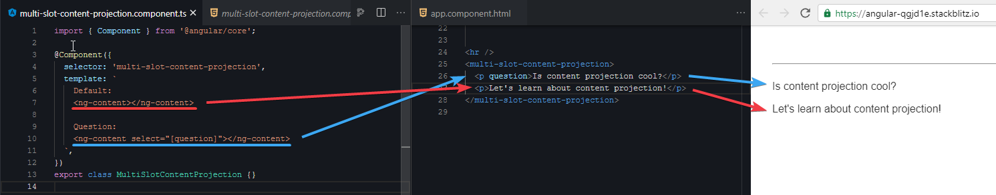
Multi-slot content projection
Live demo

Slide 41
@ContentChild
Use to get the first element or the directive matching the selector from the content DOM
Content queries are set before the ngAfterContentInit callback is called.
Does not retrieve elements or directives that are in other components' templates, since a component's template is always a black box to its ancestors.
Metadata Properties:
selector - The directive type or the name used for querying.
read - Used to read a different token from the queried element.
static - True to resolve query results before change detection runs, false to resolve after change detection. Defaults to false.

Slide 42
@ViewChild
Property decorator that configures a view query.
The ViewChild decorator returns the first element that matches a given directive, component, or template reference selector
View queries are set before the ngAfterViewInit callback is called.
The @ViewChild decorator cannot see across component boundaries
Metadata Properties:
selector - The directive type or the name used for querying.
read - Used to read a different token from the queried elements.
static - True to resolve query results before change detection runs, false to resolve after change detection. Defaults to false.
Demo

Slide 43
Angular Internationalization
Internationalization , sometimes referenced as i18n, is the process of designing and preparing your project for use in different locales around the world.
Localization is the process of building versions of your project for different locales
The localization process includes the following actions.
Extract text for translation into different languages
Format data for a specific locale
Example of translation an Angular application, using ngx-translate:
npm install @ngx-translate/core @ngx-translate/http-loader rxjs --save
Live demo
Read more at: https://angular.io/guide/i18n-common-overview

Slide 44
Component lifecycle
Starts when Angular instantiates the component class
Renders the component view along with its child views
Continues with change detection, as Angular checks to see when data-bound properties change, and updates both the view and the component instance as needed
Ends when Angular destroys the component instance and removes its rendered template from the DOM

Slide 45
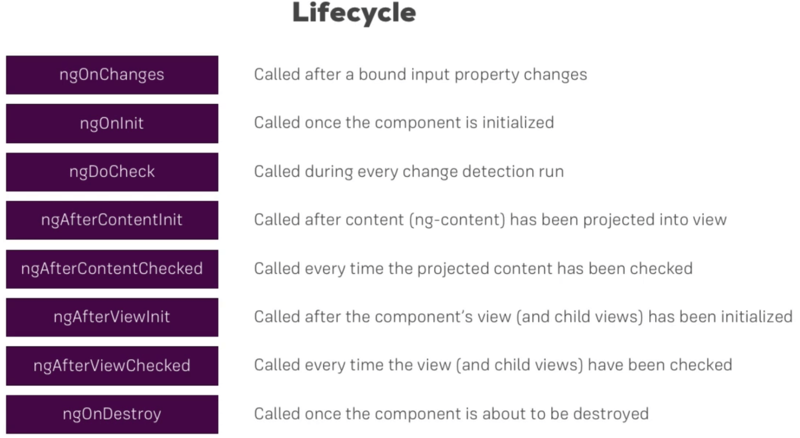
Component lifecycle hooks
https://angular.io/guide/lifecycle-hooks#lifecycle-event-sequence

Slide 46
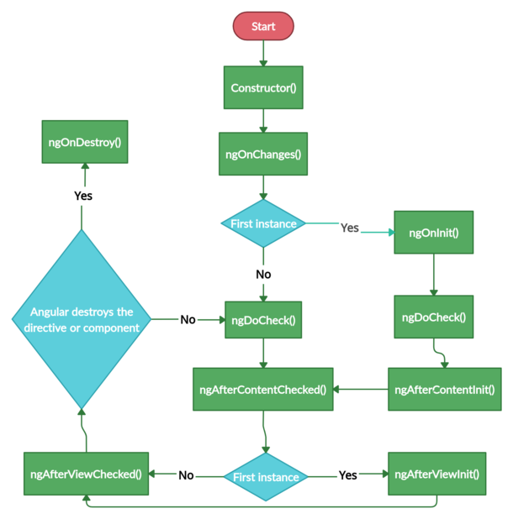
Component lifecycle hooks
Reference: https://www.study24x7.com/post/96394/lifecycle-hooks-a-component-instance-has-a-lifecycle-th-1

Slide 47
Change Detection
Change Detection means updating the DOM whenever data is changed (@Input)
Angular change detector will traverse the component tree and update the DOM
Caused by:
Events fired such as button click, etc.
AJAX call or XHR requests.
Use of JavaScript timer functions such as setTimeOut , SetInterval
ChangeDetectionStrategy: Default vs OnPush

Slide 48
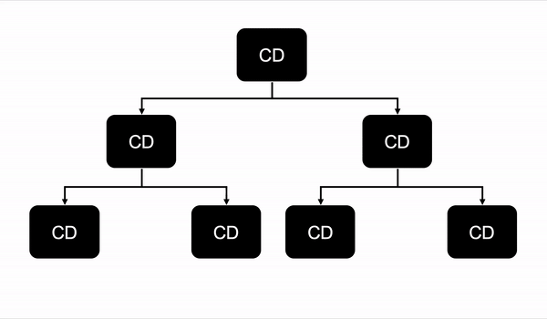
Change Detection: Default
Component will run the change detector whenever any data is mutated or changed

Slide 49
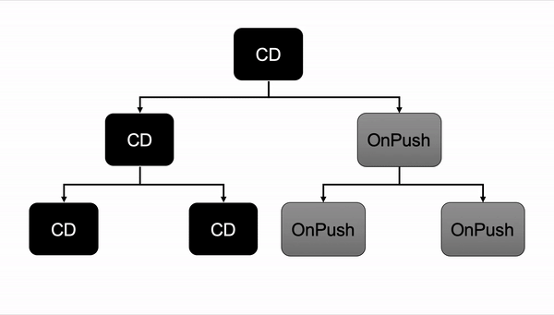
Change Detection: OnPush
Component only run the change detector when a new reference is passed to @Input() data
https://www.mokkapps.de/blog/the-last-guide-for-angular-change-detection-you-will-ever-need/

Slide 50
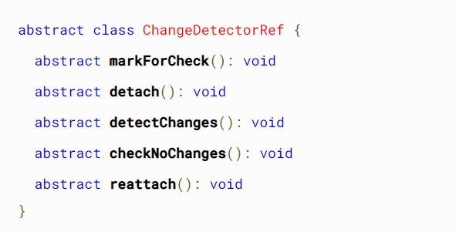
Change Detection: ChangeDetectorRef
https://angular.io/api/core/ChangeDetectorRef

Slide 51
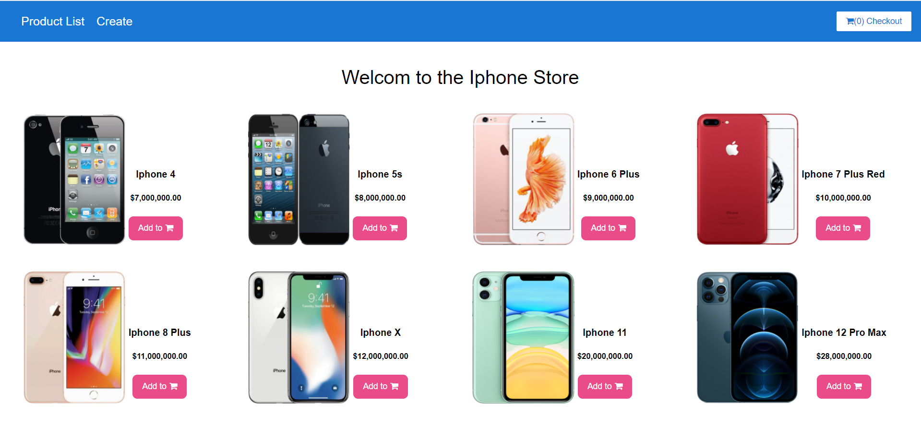
Assignment
TopBarComponent
ProductListComponent
ProductDetailsComponent

Slide 52
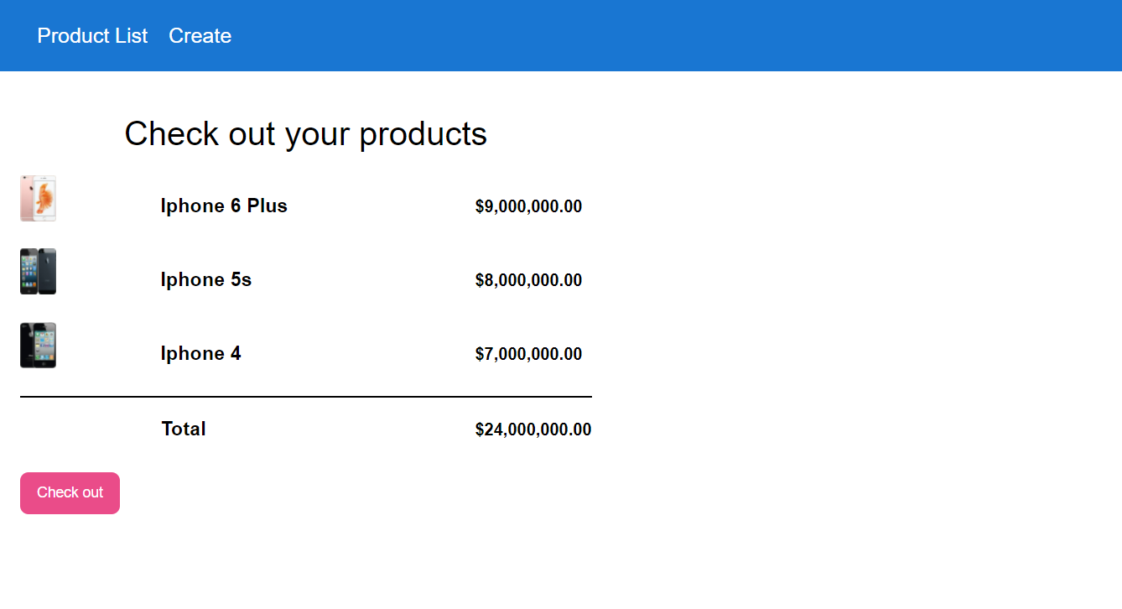
Assignment
TopBarComponent
CheckOutComponent

Slide 53
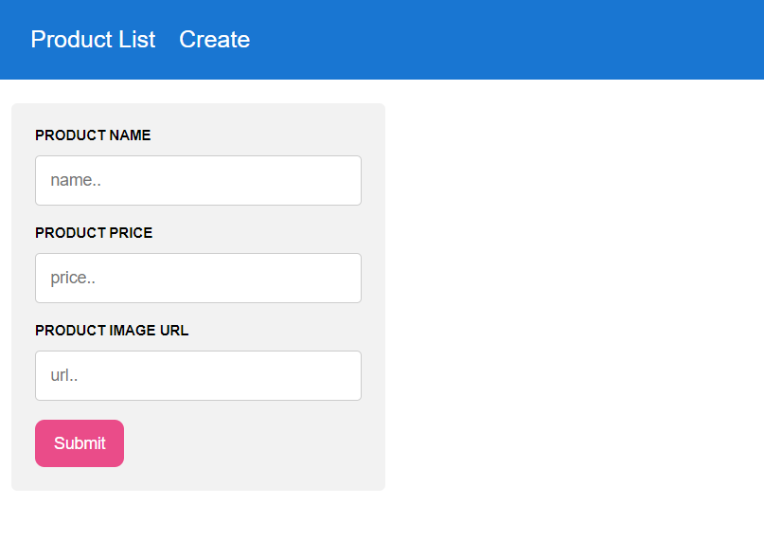
Assignment
TopBarComponent
ProductCreateComponent

Slide 54
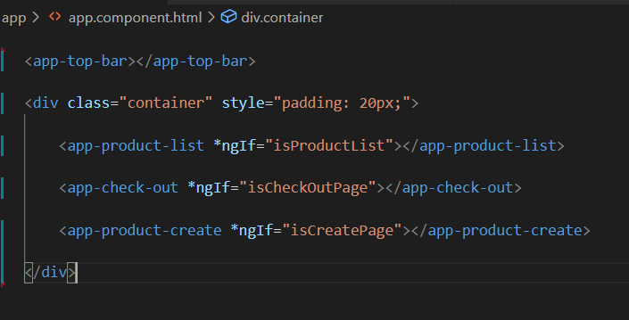
Assignment
Communicate using service between product-list, check-out and product-create service https://kms-angular-training.azurewebsites.net/

Slide 55
Service and Dependency Injection
Dependency Inversion Principle (DIP): decoupling dependencies between high-level and low-level layers through shared abstractions
Invert of Control (IoC) - aka the Holywood Principle: "Don't call us, we'll call you"
inverts the flow of control as compared to traditional control flow (procedural programming)
(https://martinfowler.com/bliki/InversionOfControl.html )
to implement inversion of control:
+ Service locator pattern
+ Delegate
+ template method design pattern
+ strategy design pattern
+ Event
+ Dependency Injection
...
Dependency Injection (DI): ...

Slide 56
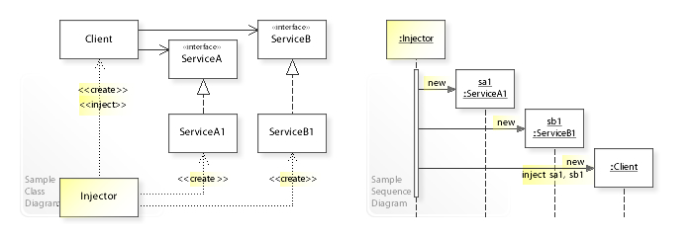
Service and Dependency Injection
Dependency Injection (DI):
is a technique in which an object receives other objects that it depends on, called dependencies.
The receiving object is called a client and
The passed-in ('injected') object is called a service
The code that passes the service to the client is called the injector
Instead of the client specifying which service it will use, the injector tells the client what service to use

Slide 57
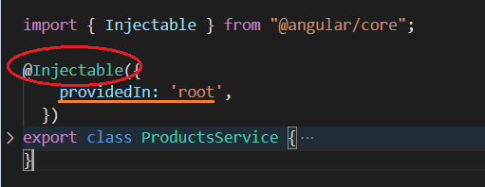
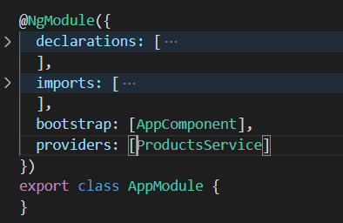
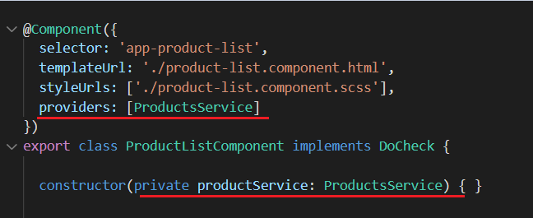
Angular’s DI Framework

Slide 58
Angular’s DI Framework
The @Injectable() decorator specifies that Angular can use this class in the DI system
The metadata, providedIn: 'root', means that the Service is visible throughout the application - no need to declare it in the providers

Slide 59
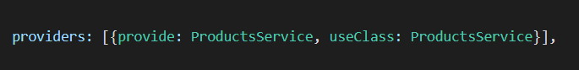
Angular’s DI Provider
A dependency provider configures an injector with a DI token, which that injector uses to provide the runtime version of a dependency value
Can be configured at @Component or @NgModel (scope of the instances)
DI Token
provider-definition key
dependency value to create
provider-definition key: can be useClass, as in the example. It can also be useExisting, useValue, or useFactory. Each of these keys provides a different type of dependency

Slide 60
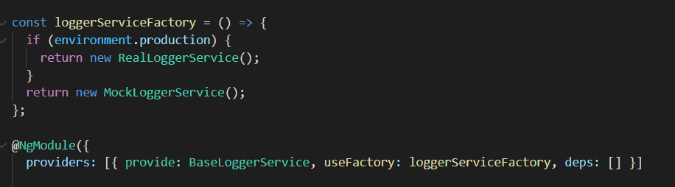
Angular’s DI Provider
(useFactory example)

Slide 61
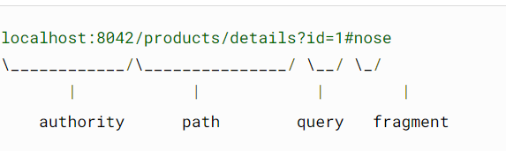
Routing
To handle the navigation from one view to the next, you use the Angular Router.
The Router enables navigation by interpreting a browser URL as an instruction to change the view

Slide 62
Routing Strategy
HTML5 style (without hash - #):
<base href="/">: The router uses the browser's history.pushState for navigation
localhost:4200/products/details?id=1#extraFragment
HashLocationStrategy: used to configure the Location service to represent its state in the hash fragment of the browser's URL
Use HashLocationStrategy by providing the useHash: true in an object as the second argument of the RouterModule.forRoot() in the AppModule
imports: [RouterModule.forRoot([], { useHash: true })]
localhost:4200/#/products/details?id=1

Slide 63
Defining a Basic Routing
Define routes array
Import RouterModule.forRoot(routesArray) to AppModule
Add the routes to the application by using routerLink in the html template
Declare <router-outlet></router-outlet> in the component template to render corresponding components

Slide 64
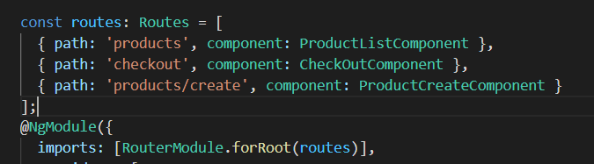
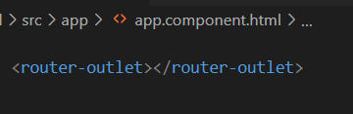
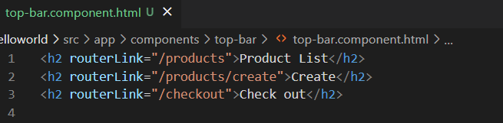
Defining a Basic Routing

Slide 65

Nested Routing

Slide 66


Basic Usage of Router, ActivatedRoute
Use ActivatedRoute to get route information such as param, fragment,...
Use Router to programmatically navigate to a route

Slide 67
Route Guards
Use route guards to prevent users from navigating to parts of an application without authorization. The following route guards are available in Angular:
CanActivate: deciding if a route can be accessed
CanActivateChild: deciding if a child route can be access
CanDeactivate: deciding if user can leave current route
Resolve: resolve data during navigation
CanLoad: deciding if children can be loaded (lazy loading)

Slide 68


Lazy Loading
You can configure your routes to lazy load modules, which means that Angular only loads modules as needed, rather than loading all modules when the application launches
Preloading modules: Preloading modules improves UX by loading parts of your application in the background so users don't have to wait for the elements to download when they activate a route

Slide 69

RxJs - Observer pattern
https://refactoring.guru/design-patterns/observer

Slide 70


RxJs - Observer pattern
https://refactoring.guru/design-patterns/observer
Publisher notify new data to subscribers by iterating the subscribers array and invoke updatethe update() functions
Subscribers can be registered to the Publisher via the method addSubScriber(sub)

Slide 71
RxJs - Reactive Extensions Library for JavaScript
https://rxjs.dev/guide/overview
RxJS is a library for composing asynchronous and event-based programs by using observable sequences
ReactiveX combines the Observer pattern with the Iterator pattern and functional programming with collections to fill the need for an ideal way of managing sequences of events
The essential concepts in RxJS:
Observable
Observer
Subscription
Operators: are pure functions with operations like map, filter, concat, reduce, etc.
Subject

Slide 72

RxJs - Observer
Is a consumer of values delivered by an Observable
Observers are simply a set of callbacks, one for each type of notification delivered by the Observable: next, error, and complete

Slide 73


RxJs - Observable
Lazy Push collections of multiple values
A function that can return a stream of values to an observer over time, this can either be synchronously or asynchronously
const foo = new Observable(subscriber => { let xhttp = new XMLHttpResquest()
xhttp.onreadystatechange = function() {
subscriber.next(this.responseText);
};
xhttp.open(‘GET’, ‘ajax_info.txt’, true);
xhttp.send();
});

Slide 74

RxJs - Subscription
Is an object that represents a disposable resource

Slide 75


RxJs - Subject
implements both the Observable and the Observer interfaces
Observables are unicast by design and Subjects are multicast by design
Subject
Observable

Slide 76
RxJs - Observables vs Promises
Observables | Promises
Emit multiple values over a period of time. | Emit a single value at a time.
Are lazy: they’re not executed until we subscribe to them using the subscribe() method. | Are not lazy: execute immediately after creation.
Have subscriptions that are cancellable using the unsubscribe() method, which stops the listener from receiving further values. | Are not cancellable.
Provide the map for forEach, filter, reduce, retry, and retryWhen operators. | Don’t provide any operations.
Deliver errors to the subscribers. | Push errors to the child promises.

Slide 77
Making HttpRequests
Angular provides a client HTTP API for Angular applications, the HttpClient service class in @angular/common/http
Offers the following major features:
The ability to request typed response objects.
Streamlined error handling.
Testability features.
Request and response .interception
Popular API: use Observables to stream data
HttpClient.get()
HttpClient.post()
HttpClient.put()
HttpClient.delete()

Slide 78

Making HttpRequests
let productsObservable = this.http.get<Product>(‘localhost:4200/products’, options) .pipe(catchError(error => {console.log(‘global error handling’)}));
productsObservable.subscribe({ next: (data) => console.log(data), error: (err) => console.log(err) })

Slide 79

Making HttpRequests: Interception
Interceptors can perform a variety of implicit tasks, from authentication to logging, in a routine, standard way, for every HTTP request/response.
Without interception, developers would have to implement these tasks explicitly for each HttpClient method call.

Slide 80

Template-Driven and Reactive Form
Key Differences
Template-driven forms make use of the "FormsModule", while reactive forms are based on "ReactiveFormsModule".
Template-driven forms are asynchronous in data flow, whereas Reactive forms are mostly synchronous.
In a template-driven approach, most of the logic is driven from the template, whereas in reactive-driven approach, the logic resides mainly in the component or typescript code.

Slide 81
Template-Driven and Reactive Form
Choosing an Approach
Reactive forms are more scalable, reusable, and testable. If forms are a key part of your application, or you're already using reactive patterns for building your application, use reactive forms.
Template-driven forms are useful for adding a simple form to an app, such as an email list signup form. But they don't scale as well as reactive forms. If you have very basic form requirements and logic, template-driven forms could be a good fit.

Slide 82
Setting up the form model
Both reactive and template-driven forms are built on the following base classes:
FormControl tracks the value and validation status of an individual form control.
FormGroup tracks the same values and status for a collection of form controls.
FormArray tracks the same values and status for an array of form controls.
ControlValueAccessor creates a bridge between Angular FormControl instances and built-in DOM elements.

Slide 83
Build a Reactive Form
There are three steps to using form controls.
Register the reactive forms module (ReactiveFormsModule) in your application. This module declares the reactive-form directives that you need to use reactive forms.
Generate a new FormControl instance and save it in the component.
Register the FormControl in the template.

Slide 84

Build a Reactive Form

Slide 85



Build a Reactive Form

Slide 86
Build a Template-Driven Form
Template-driven forms rely on directives defined in the FormsModule.
The NgModel directive reconciles value changes in the attached form element with changes in the data model, allowing you to respond to user input with input validation and error handling.
The NgForm directive creates a top-level FormGroup instance and binds it to a <form> element to track aggregated form value and validation status. As soon as you import FormsModule, this directive becomes active by default on all <form> tags. You don't need to add a special selector.
The NgModelGroup directive creates and binds a FormGroup instance to a DOM element.

Slide 87

Build a Template-Driven Form

Slide 88



Build a Template-Driven Form

Slide 89

Reactive Form - Validation
(https://angular.io/guide/form-validation)
Validator functions:
Sync validators
Async validators
Built-in validator functions (https://angular.io/api/forms/Validators)

Slide 90

Reactive Form - Validation Defining custom validators

Slide 91

Reactive Form - Validation Adding custom validators to reactive forms

Slide 92

Reactive Form - Validation Adding custom validators to reactive forms

Slide 93
Template-Driven Form - Validation (https://angular.io/guide/form-validation)
use the same validation attributes as native HTML form validation to add validation to a template-driven form.
Angular uses directives to match these attributes with validator functions in the framework
Pattern
Min
Max
Required
Minlength
Maxlength
Step
(https://developer.mozilla.org/en-US/docs/Web/Guide/HTML/Constraint_validation)

Slide 94

Template-Driven Form - Validation
Define Custom validation

Slide 95

Template-Driven Form - Validation
Adding custom validators to template-driven forms

Slide 96
Form - Control Status CSS Classes
Angular automatically mirrors many control properties onto the form control element as CSS classes. Use these classes to style form control elements according to the state of the form. The following classes are currently supported.
.ng-valid
.ng-invalid
.ng-pending
.ng-pristine
.ng-dirty
.ng-untouched
.ng-touched
.ng-submitted (enclosing form element only)

Slide 97

Form - Popular API from FormGroup
(https://angular.io/api/forms/FormGroup)

Slide 98
Others
Angular Internationalization
Angular Universal
State Management: NgRx,...
Dynamic Components
Angular Element
Angular Animation
Testing

Slide 99
THANK YOU

